Slide 1

(Management Topic in Environmental Studies)
B. Tech 7TH Semester
Multidisciplinary nature and scope and objective of environmental studies
Unit 1
Department: Chemistry
Subject: MTES (CHM 2049)

Slide 2
Contents
Introduction
Objectives of Environmental Studies
Guiding principles of environmental education
Scope of environmental studies
Importance’s of environmental studies
Major environmental issues

Slide 3
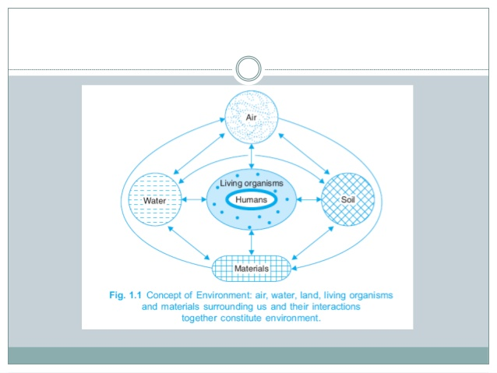
Introduction
The word ‘Environment’ is derived from the French word ‘Environner’ which means to encircle, around or surround
Environment: The circumstances and conditions surround and affect/ influence the growth and development of a organism.
Environment is the sum total of land, water, air, interrelationships among themselves and also with the human beings and other living organisms
2. Douglas and Holland defined that ‘The term environment is used to describe, in aggregate, all the external forces, influences and conditions, which affect the life, nature, behaviour and the growth, development and maturity of living organisms’.

Slide 4
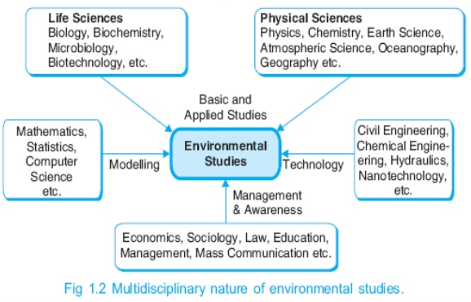
Introduction
Environmental Science: is the interdisciplinary field and it is the study of the interactions among the physical, chemical and biological components of the Environment with a focus on environmental pollution and degradation.
The term ‘Ecology’ is derived from Greek word ‘Oekologue’ which is composed of two words:
(a) ‘Oekos’ means surrounding
(b) ‘Logs’ means study on a whole ecology means ‘Study of surrounding’

Slide 5
Objectives of Environmental Studies
According to UNESCO (1971), the objectives of environmental studies are:
Creating the awareness about environmental problems among people and students.
Imparting basic knowledge about the environment and its related problems.
Developing an attitude of concern for the environment.
Motivating public to participate in environment protection and environment improvement.
Acquiring skills to help the concerned individuals in identifying and solving environmental problems.
Striving to attain harmony with Nature.

Slide 6
Guiding principles of environmental education
According to UNESCO, the guiding principles of environmental education should be as follows:
Environmental education should be compulsory, right from the primary up to the post graduate stage.
Environmental education should have an interdisciplinary approach by including physical, chemical, biological as well as socio-cultural aspects of the environment. It should build a bridge between biology and technology.
Environmental education should take into account the historical perspective, the current and the potential historical issues.
Environmental education should emphasize the importance of sustainable development i.e., economic development without degrading the environment without comprising for the future generation.
Environmental education should emphasize the necessity of seeking international cooperation in environmental planning.
Environmental education should lay more stress on practical activities and first hand experiences.

Slide 7
The disciplines included the following science and engineering principle.
(a) Environmental Science:
It is the scientific study of the environmental system particularly adoptation and interaction of biotic component with the abiotic components (air, water, soil and land, temp, light), of the Environment with a focus on environmental pollution and degradation.
(b) Environmental Engineering:
It deals with the study of technical processes involved in the protection of environment from the potentially deleterious effects of human activity and improving the environmental quality for the health and well beings of humans.
(c) Environmental Management:
It promotes due regard for physical, social and economic environment of the enterprise or projects. It encourages planned investment at the start of the production chain rather than forced investment in cleaning up at the end.
It generally covers the areas as environment and enterprise objectives, scope, and structure of the environment, interaction of nature, society and the enterprise, environment impact assessment, economics of pollution, prevention, environmental management standards etc.

Slide 8
Scope of environmental studies
Environmental studies discipline has multiple and multilevel scopes
The study Natural resources their conservation and efficient management.
It provides the knowledge about ecological systems and Biodiversity
It provides necessary information about biodiversity richness and the potential dangers to the species of plants, animals and microorganisms in the environment.
The study enables one to understand the causes and consequences due to natural and main induced disasters (flood, earthquake, landslide, cyclones etc.,).
Sources of environmental pollutions and control measures
It enables one to evaluate alternative responses to environmental issues before deciding an alternative course of action.

Slide 9
Scope of environmental studies
The study enables to know the environmental acts, rights, rules, legislations, etc.) to make appropriate judgments and decisions for the protection and improvement of the earth.
The study exposes the problems of over population, health, hygiene, etc.
Social issues in relation to development and Environment
Research and Development to monitor and controlling technology to solve various environmental issues.
It teaches the citizens the need for sustainable utilization of resources
Human population and Environment
Environmental journalism: To generates awareness among people regarding environmental issues

Slide 10
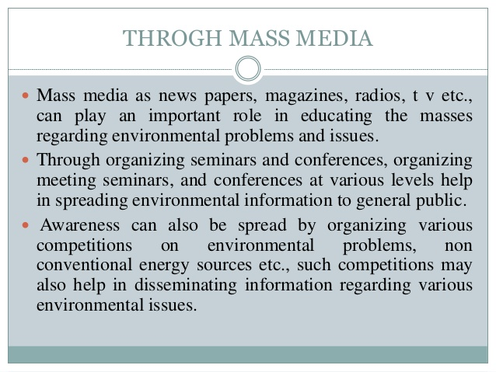
Through Mass media

Slide 11
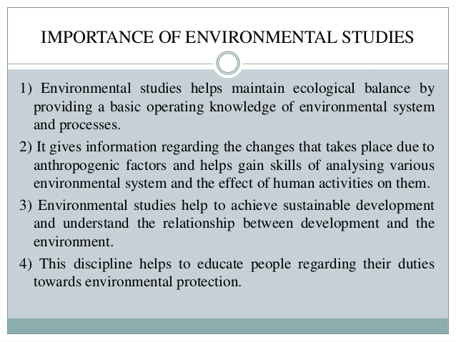

Importance of Environmental Study

Slide 12
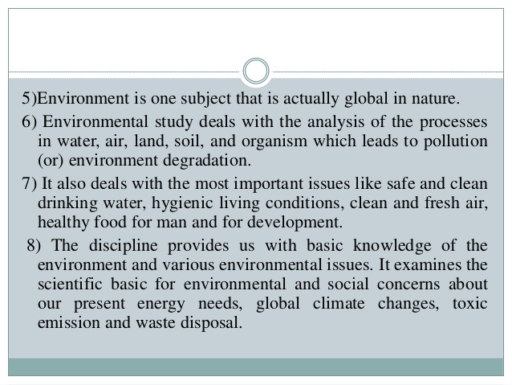
Importance of Environmental study

Slide 13
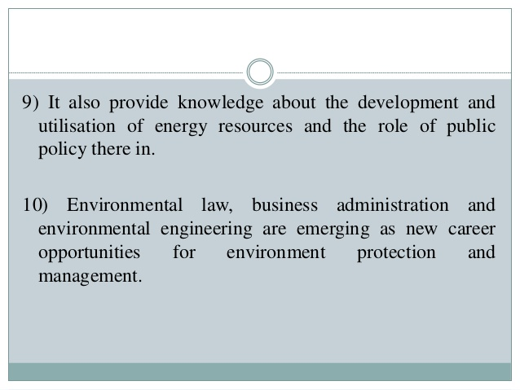
Importance of Environmental study

Slide 14
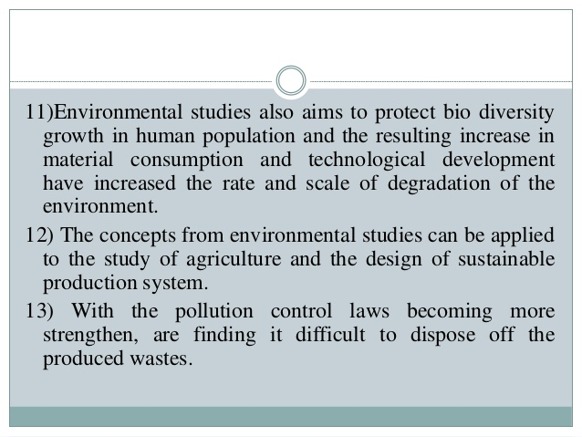
Importance of Environmental study

Slide 15
Environment and its segments
Environment consists of four segments.
1. Atmosphere: Blanket of gases surrounding the earth.
2. Hydrosphere: Various water bodies present on the earth.
3. Lithosphere: Contains various types of soils and rocks on the earth.
4. Biosphere: Composed of all living organisms and their interactions with the environment.

Slide 16
Atmosphere:
The following points highlight the vital role played by atmosphere in the survival of life in this planet.
The atmosphere is the protective blanket of gases which is surrounding the earth. It protects the earth from the hostile environment of outer space.
It absorbs IR radiations emitted by the sun and reemitted from the earth and thus controls the temperature of the earth
It allows transmission of signicant amounts of radiation only in the regions of 300 { 2500 nm (near UV, Visible, and near IR) and 0.01 { 40 meters (radio waves). i.e it lters tissue damaging UV radiation below 300 nm.
It acts as a source for CO₂ for plant photosynthesis and O2 for respiration
It acts as a source for N₂ for nitrogen xing bacteria and ammonia producing plants.
The atmosphere transports water from ocean to land.

Slide 17
Hydrosphere:
The hydrosphere is a collective term given to all dierent forms of water.
It includes all types of water resources such as oceans, seas, rivers, lakes,
streams, reservoirs, glaciers and ground waters.
It covers more than 75 % of the earth surface.
Lithosphere: The earth is divided in to layers.
Crust: The crust is the earth's outer skin that is accessible to human.
The crust consists of rocks and soil of which the latter is the important part of lithosphere.
Mantle: It is the middle layer of the earth and is made up of dierent types of rocks (Igneous, sedimentary and metamorphic)
Core: It is the innermost geological layer of the Earth. It is primarily asolid ball of rocks and minerals.
The lithosphere consists of upper mantle and the crust.
Biosphere:
The biosphere or ecosphere is a global ecosystem composed of living organisms (biota) and the abiotic (nonliving) factors from which they derive energy and nutrients.
It extends from 2 kilometres into the atmosphere t

Slide 18
Vertical structure of atmosphere
Troposphere
The bottom layer of the atmosphere that stretches about 11 Km
Contains 75 % of the air
Temperature decreases with altitude
Storms and rainfall take place
Made up of mostly N2 & O2

Slide 19
Stratosphere
The second layer of the atmosphere that extends up to 50km.
Contains 24 % of the air
Temperature increases with altitude
Contains ozone (O3) layer that protects us from harmful ultraviolet rays
Mesosphere
The third layer of the atmosphere that extends up to 80 km.
Temperature decreases with altitude
The coldest layer
Here most meteors burn up

Slide 20
Thermosphere (ionosphere and exosphere)
The fourth layer of the atmosphere that stretches about 1000 km.
The hottest layer due to the ions (H+ and He􀀀) that directly absorb the sun's radiation
Temperature increases with altitude
Where radio waves are reflected.

Slide 21
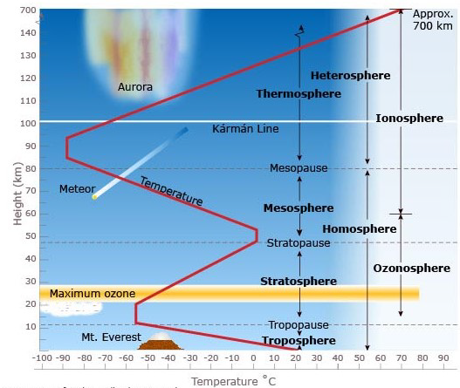
Vertical structure of atmosphere

Slide 22


